Slide 1


Vision Empower Trust AI Skilling Program
MODULE 3
AI for VI
Vision Empower Trust

Slide 2
Agenda
Item | Details
Audience | Teachers, special educators, resource persons and school leaders working with visually impaired students
Duration | 90 minutes
Mode | Hands on
Module purpose | This module will help teachers understand how AI can support persons with visual impairment in education, daily living, mobility, communication, and independent access to information. It will also help teachers understand the limitations of AI and the need for safe, responsible and verified use.
Session principle | This session is practical and teacher-centered, with a focus on using AI responsibly to create inclusive, accessible, and personalized learning resources. Teachers will learn through hands-on activities and refine prompts to achieve better AI-generated outcomes.

Slide 3
Learning Outcomes
Explain how AI can support persons with visual impairment.
Identify AI tools that help with reading, image description, navigation, translation, communication and learning.
Understand how AI can act as a support for “substitution of vision” in some situations.
Recognise the limitations and risks of using AI tools.
Guide VI students to use AI safely and independently.
Apply a simple verification habit before trusting AI output.

Slide 4
Pre-Assessment
Can AI be used by the visually impaired?
Do you know any of the tools that can be used by AI
What are the guardrails and checks to be done when using AI as a VI person

Slide 5
Why AI for VI?
AI can give access to visual information through speech, text, audio and other alternate user interfaces, making visual information accessible
Special AI models are rigorously trained to perform many human functions that can be helpful for the VI community
  Image recognition
  Speech recognition
  Speech to text, text to speech conversion
  Language Translation, Transcription of text, audio or video
  OCR by converting inaccessible text to digital text

Slide 6
AI in Assistive Technologies and
AI as Assistive Technology
Many Assistive Technology solutions are becoming AI enabled
  Be My Eyes -> Be My AI
  YouDescribe volunteer led Video Transcription -> AI led transcription with human verification
AI by itself can perform functions that can help in accessibility
  Seeing AI – Computer Vision to convert images to textual/ audio description
  Generative AI to generate description of images as text / audio or creation of audio to text
  Knowing about colour changes in chemistry experiments using AI tools
AI can help in compensating vision loss to a certain extent

Slide 7
Some AI tools for VI users
Generative AI Tools (Covered in Module 2)
  Microsoft CoPilot
  ChatGPT
  Suno AI
  Sarvam AI
Special AI Tools
  Be My AI
  Microsoft Seeing AI
  Google Lookout
  Braille AI Tutors like https://braille.academy/ai-tutor
  AI-Learners which help personalize learning for the students
Some of these tools are described below.

Slide 8


Microsoft Seeing AI – A Visual Assistant for the Blind
Assistance with daily tasks like reading text, describe photos or people, objects, scenes, currency, colours, products and images.
It is designed specifically with and for blind and low-vision users
Vision Empower Tutorials : https://www.youtube.com/watch?v=ba-AqvGH7ag&list=PLE5Q6U3y6x5YgzNeiae_hHvzml58tSiNR

Slide 9


Be My AI – AI Powered Assistant to Virtual Volunteer Be My Eyes
Have you used Be My Eyes as a VI person or as a volunteer?
Be My AI is a digital visual assistant built into the Be My Eyes app that uses artificial intelligence to describe images and answer questions for people who are blind or have low vision.
Take Pictures: Capture photos using your phone camera to get detailed descriptions of your surroundings.
Ask Follow-Ups: Chat with the AI to ask specific questions about objects, text, or details in the photo.
Share Images: Send pictures directly from your photo gallery, social media, or messaging apps like WhatsApp using the share menu.
Human Backup: Connect with a live human volunteer if you need extra help or have urgent safety questions.
Vision Empower Tutorials: https://www.youtube.com/watch?v=5ifjPWXYZjs&list=PLE5Q6U3y6x5aDK964XeWeSEnlnlEwlp56

Slide 10

Microsoft CoPilot
Gen AI that can convert visual data into descriptive text, reading screen content aloud, and supporting screen readers like NVDA and Narrator
Users can paste graphs, charts, or photos into Copilot and ask it to describe visual elements in detail
Screen Reading Support: Works with Windows Narrator and third-party screen readers to read web pages, emails, and documents aloud with natural voices
Allows users to share their active screen or window and interact entirely via natural voice commands without needing to see the layout.
Vision Empower Tutorials : https://www.youtube.com/watch?v=xZgO4QBKGrU&list=PLE5Q6U3y6x5boMKBiqa0ZuvX-kDdp5nOn

Slide 11
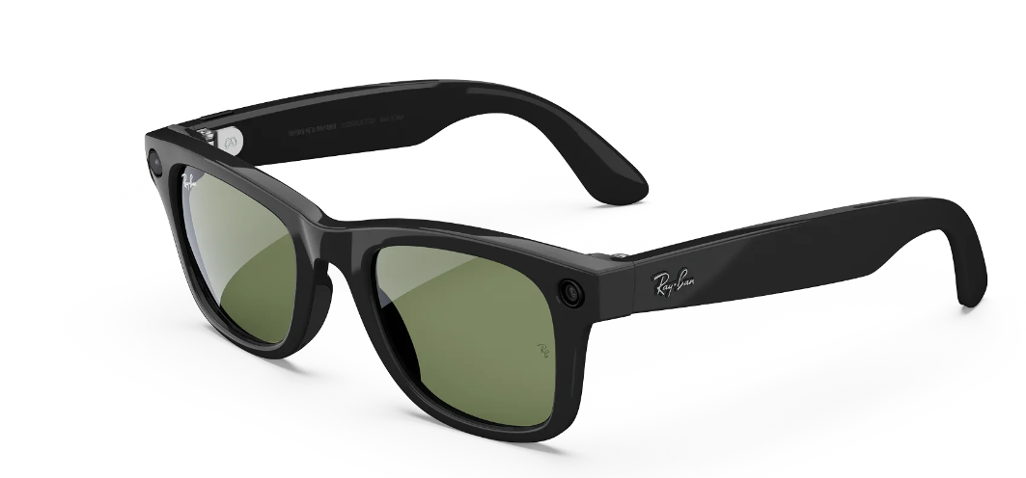
AI-enabled smart glasses
Envision Glasses and Meta AI-enabled glasses are being explored for hands-free visual assistance
Be My Eyes has also been integrated with Meta AI glasses, allowing users to receive visual assistance through wearable technology.

Slide 12
Risks and limitations
AI can be wrong even when it sounds confident.
Tools can misread text, miss details, describe an image incorrectly, or give incomplete information.
They should not be used as the final authority in high-risk situations
VI users should avoid depending only on AI for medicines, dosage, allergens, road crossing, legal documents, exams, financial transactions, identity verification, or emergency decisions
Be My Eyes specifically says not to use Be My AI for scanning medicines, reading dosages, or other safety issues.
Image descriptions may miss context, facial recognition may be incorrect
Good lighting and contrast plays an important role in the proper description of images
Privacy must be protected, personal, sensitive, confidential data should not be shared
AI may increase overdependence, causing harm to creativity and critical thinking
Notes:
1. Common risks across Seeing AI, Be My AI and Copilot
AI can be wrong even when it sounds confident.
These tools may give useful descriptions or answers, but they can misread text, miss details, describe an image incorrectly, or give incomplete information. Microsoft says Copilot can make mistakes, and Be My Eyes states that Be My AI output may contain hallucinations or be inaccurate.
They should not be used as the final authority in high-risk situations.
VI users should avoid depending only on AI for medicines, dosage, allergens, road crossing, legal documents, exams, financial transactions, identity verification, or emergency decisions. Be My Eyes specifically says not to use Be My AI for scanning medicines, reading dosages, or other safety issues.
Image descriptions may miss context.
An AI tool may describe what is visible in a picture but may not understand the real situation, urgency, cultural context, safety risk, or learning objective. This is especially important for classroom diagrams, mobility, labels, and official documents.
Privacy must be protected.
Photos, chats, prompts, uploaded documents, or camera/screen content may be processed by the service provider. Be My Eyes explains that photos and chats submitted to Be My AI are processed to provide descriptions and follow-up options, while Microsoft Copilot processes prompts and conversation context to generate responses.
AI may increase overdependence.
Students and adults may start accepting AI output without thinking, checking, or asking for help. The safe message is: AI supports independence, but responsible independence includes verification.
2. Seeing AI: risks and limitations
Seeing AI is useful for reading text, documents, products, currency, scenes, colours, light, and photos. Microsoft describes Seeing AI as an app that narrates the world for blind and low-vision users, with features such as richer photo descriptions and document chat.
Area
Risk / limitation
What VI users should do
Text reading
OCR may misread unclear print, handwritten text, poor lighting, unusual fonts, or damaged pages.
Re-scan, improve lighting, or verify important text.
Documents
Layout, tables, columns, maths, signatures, stamps, or handwritten notes may not be read correctly.
Use for first access, but check important documents with a trusted person or accessible source.
Product/barcode reading
Product information may be incomplete or unavailable. Packaging changes may not match database information.
Do not rely on it for allergens, expiry dates, or medicine instructions.
Currency recognition
Folded, torn, old, or unfamiliar notes may be misidentified.
Verify large-value transactions.
Colour recognition
It identifies perceived colour, which can change with lighting and camera angle.
Use as guidance, not as exact confirmation.
Scene description
Scene descriptions may be general and may miss obstacles, people movement, danger, or important details.
Do not use it for road crossing or safety-critical navigation.
Person description
Describing age, emotion, appearance, or identity can be unreliable or sensitive.
Avoid using it for identity confirmation or sensitive judgments.
3. Be My AI: risks and limitations
Be My AI can describe photos and answer follow-up questions, and users can still move from AI support to a human volunteer when needed.
Area
Risk / limitation
What VI users should do
Photo description
It may describe people, places, objects, or facts incorrectly.
Ask follow-up questions and verify important details.
Follow-up answers
The answer may sound confident but still be wrong.
Treat it as a helpful guess, not final truth.
Medicines and safety
Be My Eyes advises users not to use Be My AI for medicines, dosages, or safety issues.
Use a pharmacist, doctor, caregiver, teacher, or volunteer.
Privacy
Photos and questions submitted to Be My AI are processed to provide the service.
Avoid uploading student faces, IDs, certificates, medical information, confidential documents, or private locations.
Human support still needed
AI may not understand sensitive or complex situations.
Use the volunteer option when human judgment is needed.
4. Copilot: risks and limitations
Copilot can help VI users with writing, summarising, explaining, translation, brainstorming, and document understanding. But Microsoft clearly states that Copilot can make mistakes and that users should validate output before acting on it.
Area
Risk / limitation
What VI users should do
Facts and explanations
It may give incomplete, inaccurate, or fabricated answers.
Ask for sources and verify with trusted material.
Reports and summaries
It may omit key points or change the meaning.
Compare with the original document before using.
Translation
It may translate words but miss local context, disability-sensitive language, or educational meaning.
Human review is needed before circulation.
Data privacy
Prompts, files, images, voice, screen or camera content may be processed depending on the Copilot version and account type.
Do not enter confidential student, teacher, HR, finance, or donor information into public tools.
Decision-making
It may make recommendations that sound professional but are not suitable.
Use human judgment for final decisions.
Voice input
Speech quality, background noise, accent, and vocabulary may affect how well Copilot understands the user.
Check the prompt before trusting the answer.
Simple safety rule for VI users
Use AI for first access, not final confirmation.
A good habit is:
Pause – Check – Verify – Decide
Pause: Is this a low-risk or high-risk task?
Check: Does the output sound complete and sensible?
Verify: Can I confirm it with another source, tool, teacher, volunteer, or trusted person?
Decide: Should I use it, correct it, or reject it?
One-line message for training
AI can describe, read, explain and support independence, but it can also make confident mistakes. For important information, always verify before acting.

Slide 13
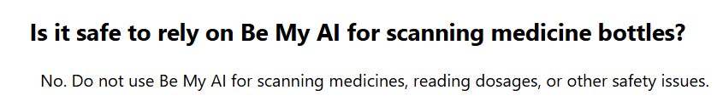
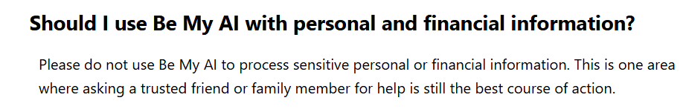
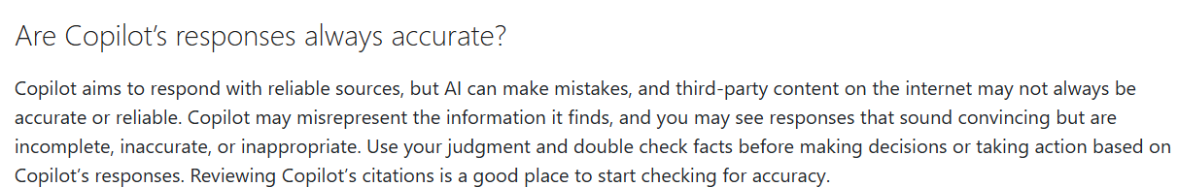
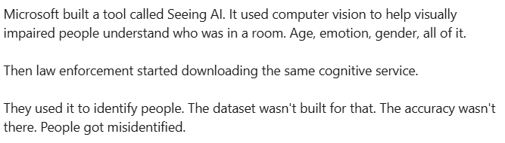
Notes:
https://support.microsoft.com/en-us/microsoft-copilot/privacy-faq-for-microsoft-copilot
https://support.bemyeyes.com/hc/en-us/articles/18133134809105-Using-Be-My-AI?utm_source=chatgpt.com
https://www.linkedin.com/posts/au-amitsingh_the-first-time-ai-got-into-real-trouble-in-ugcPost-7468071367121248256-oGQv/

Slide 14
How do we use AI if it has pros and cons?
Guardrails are built by applications to ensure accuracy for users, like Copilot
Humans are accountable for what we use AI for and how we use its outputs
Responsible, Informed and Conscious (RIC) Use of AI needs to be practiced
Responsible :
  Use AI in a manner that does not result in harm for yourself or others
Informed :
  Know that AI can make mistakes, can have bias, can make mistakes, does not have emotions
  Know that AI can generate content without it being reality (hallucination)
Conscious :
  Use AI with full understanding of the accountability for actions based on the information or suggestions that are got from the AI solutions
An Responsible, Informed and Conscious human in the loop is the best way to use AI
Pause – Check – Verify – Decide

Slide 15
Let us all remember
AI is not a substitute for
  Professional advice from teachers, doctors, CA, lawyers etc.
  Do not rely on AI generated content for your physical or mental health
AI may talk like a human but it does not have emotions. The responses are generated to make the humans “feel like they are talking to another human”
We should not develop overdependence on AI
AI is not always accurate
  Self judgement for accuracy is a must
  Lag between current updates and the training data
  Not being aware of the training the model has received
Responsibility of using AI properly is on the humans
When there is a need to get live data input, official sources information, access the sources directly without AI
Use AI only when needed as there is an environmental cost for running AI models as well due to the large computing and data storage needs

Slide 16
Post-Assessment
Can AI be used by the visually impaired?
Do you know any of the tools that can be used by AI
What are the guardrails and checks to be done when using AI as a VIperson

Slide 17
AI
can be a powerful assistant for the humans when used in an
Responsible, Informed, and
Conscious
manner

Slide 18
Thank You !

